Slide 1

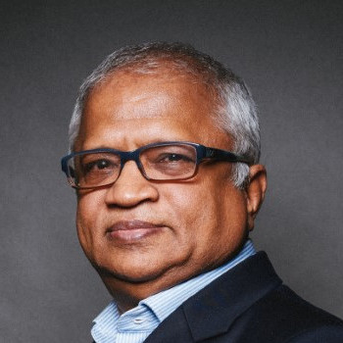

Augmenting Human Intelligence
THE & PARADIGM
FASTER & CHEAPER & BETTER: DREAM OR REALITY?
Michaela Cortez
Stan Sthanunathan​
April 2025

Slide 2

1
Where are we?
Vs
WHERE WE NEED TO BE?

Slide 3

Holy Grail…
Pursuit of Truth
A quest that often creates conflict with norms
BIG QUESTION:
Truth
OR
Rationalization of Truth
as Consumers/Insights experts want to see/say it?

Slide 4

World around us is changing at an accelerated pace
People reality
Market reality
Time Pressured
Over stimulated
Screen obsessed
Work-Life Balance Challenges
Lower barriers to entry
Categories getting cluttered
High innovation failure rate
Sluggish growth
Getting to Truth is becoming increasingly important and difficult
Photo by Stephan Seeber on Unsplash

Slide 5

Insight industry reality
If you ask questions, you will get answers.
Are the answers a reflection of truth?

Slide 6

“If I asked people what they wanted they would have said faster horses.”
Henry Ford
Firefly: Firefly a horse wearing rollerblades in dark blue studio (edited)

Slide 7

1920 | P&G starts market research in 1924. Unilever did so across the pond around the same time
1930 | Quantitative research brought to the US by European scholars (Lazarsfeld’s Survey, panel methods)
1940 | George Gallup’s telephone interviewing process yields unaided recall measure; over 200 Market Research orgs in US by 1948
1950 | Motivation research, communications research and persuasion studies proliferate; demographics and socioeconomics segment market
1960 | Rise of cognitive-based theories & factoring in of psychographics; Theory of Buyer Behavior attempts to explain rational brand choice with limited info
1970 | Shift from strictly cognitive research to attitude research which accounted for emotion, low-involvement decision making and non-conscious process
1980 | Western Wats born—leveraged telephone for survey research; bar code scanners & UPCs; Dial-a-Meter tracks ad responses for duration of an ad
1990 | The internet! First commercial online research conducted in 1995; growth of diagnostic and optimization techniques as ad production costs soar
2000 | Neuromarketing and Ethnography are applied in consumer research
2010 | Digital, Social Listening, agile tools, DIY etc.
2020 | 2020s rapid growth of DIY tools followed by use of AI for research instrument development and analysis - Faster, Better Horse
100-Year History of Insights Industry
in Pursuit of Truth
“
Evolution
Still largely rooted in
Ask Questions,
Get Answers”
vs
Revolution

Slide 8

Insights Industry under pressure
Speed now more important than ever before
Budgets constantly under pressure – only going to increase going forward
Survey lengths getting challenged
On-Line data quality issues continue to haunt us

Slide 9
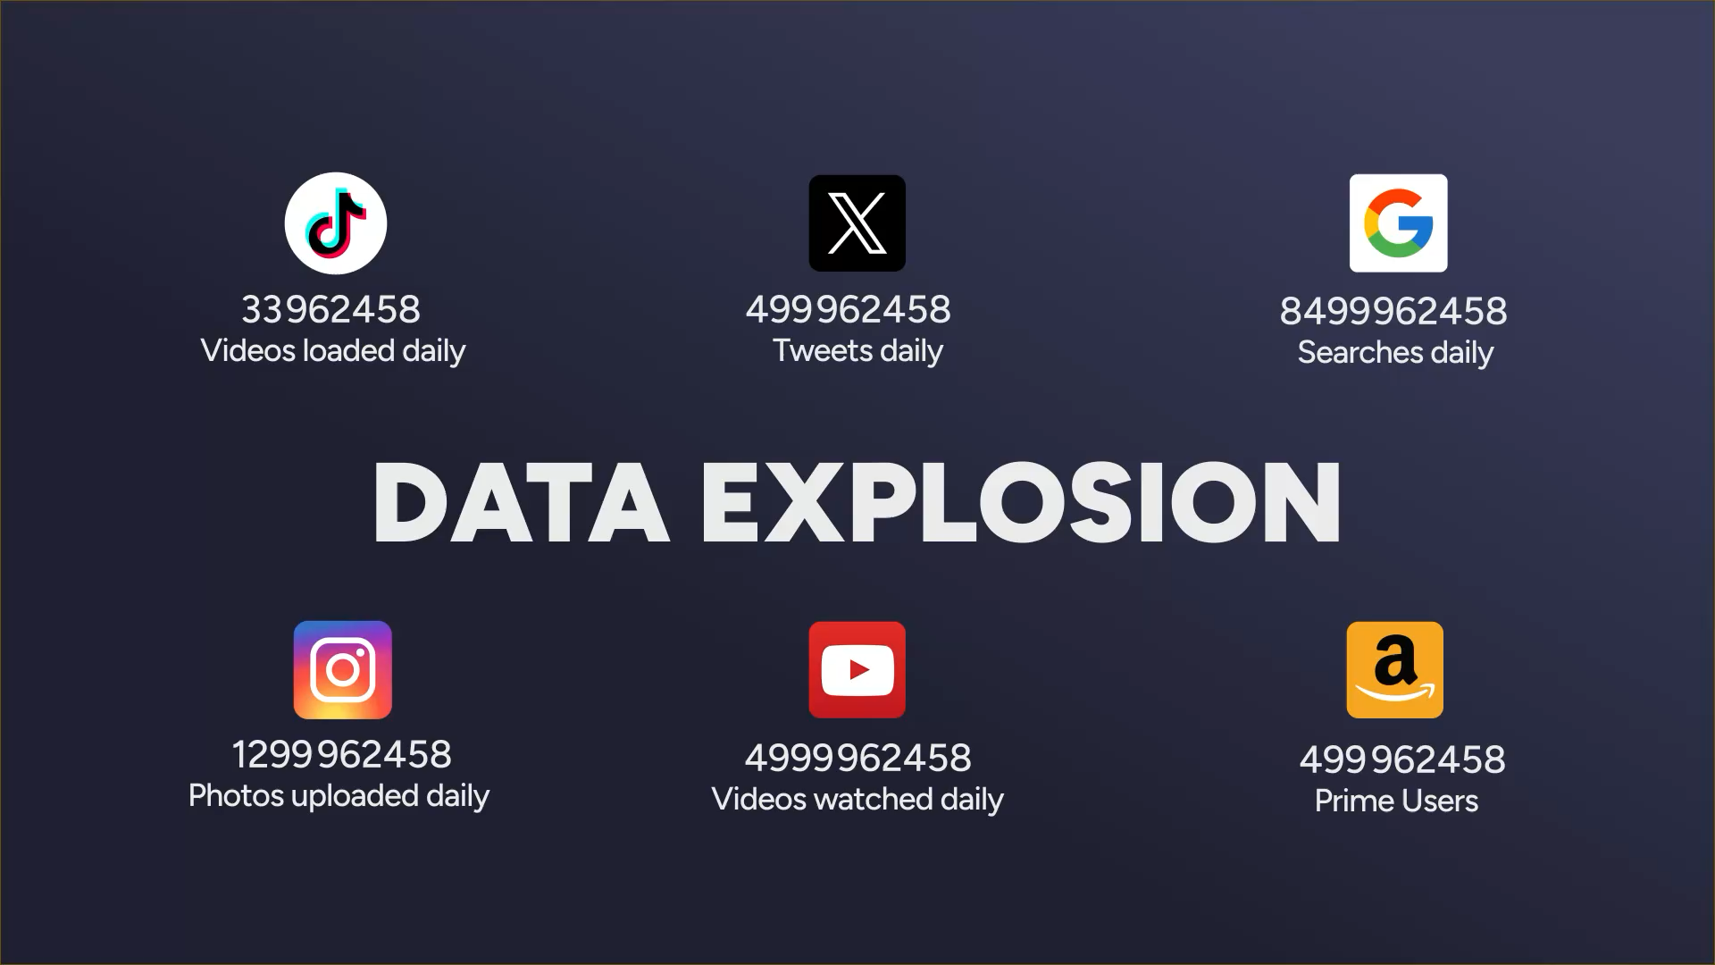
Notes:
EVERY 1 SECOND – change to video
http://www.internetlivestats.com/
We need power beyond human intelligence

Slide 10
Insights Industry under pressure
So
Now
What?

Slide 11

Focus
Groups
Survey
Research
Observe
Listen
Synthesize
Analyze
Deduce

Slide 12
Focus
Groups
Survey
Research
Observe
Listen
Synthesize
Analyze
Deduce

Slide 13

People do not have time to
but they certainly do
TALK TO US
TALK ABOUT US
Firefly prompt: a shiny ball (later deleted) under a bunch of microscopes, telescopes, cameras and lenses, on a dark blue background

Slide 14

The big opportunity
BRIDGE THE SAY-DO GAP

Slide 15
2
THE WAY FORWARD…

Slide 16
FASTER&CHEAPER&BETTER
AI ENABLED SURVEYS AND QUALITATIVE RESEARCH
AI in survey questionnaire design
AI in synthetic respondents
LLMs in analysis of qualitative data
AI in report generation
SOCIAL MEDIA LISTENING
NEXT GEN INSIGHTS PLATFORMS
AI to analyze what people “Talk about us”
AI to move from disparate date points to insights to ideas

Slide 17
Benchmark your product experience vs competition AND understand drivers of good/bad performance
Business Questions
How is my new launch performing?
Is there competitor running fast on the left lane?
Why people like/dislike my product?
What aspect of my product should I amplify?
What guidance can I provide for improving CX?
Are there hidden gems in my portfolio?
What are the gaps in my competitor’s portfolio?

Slide 18
Monitor and understand drivers of brand equity
– for your brands and your competitors
WITHOUT DOING A SINGLE SURVEY
Business Questions
Is my brand strengthening its equity vs competition?
How do I accelerate/reverse the trend?
Which of my competitors are declining and why?
How do I stack-up against ALL the brands?
Can I have an “Always On” system that monitors all this every month without spending a fortune?
How do I create equity-driven market share growth?

Slide 19
Spot actionable trends 18 months in advance at category level to power your innovation agenda
Business Questions
What is the next biggest trend in ingredients?
What are the emerging benefits/claims?
How do I prioritize them?
What are the emerging brands that I need to go up against/acquire?
Is my innovation funnel future-proofed?
What innovation activities should I sunset?

Slide 20
Create a continuous stream of qualified and quantified innovation ideas powered by GenAI
Business Questions
How do I create insights powered innovation ideas at scale?
How do I crunch my innovation cycle times from 12-18 months to 2-3 months?
How do I improve my innovation hit rates from ~10% to >25%?
How do I do all of the above Faster, Better and Cheaper

Slide 21
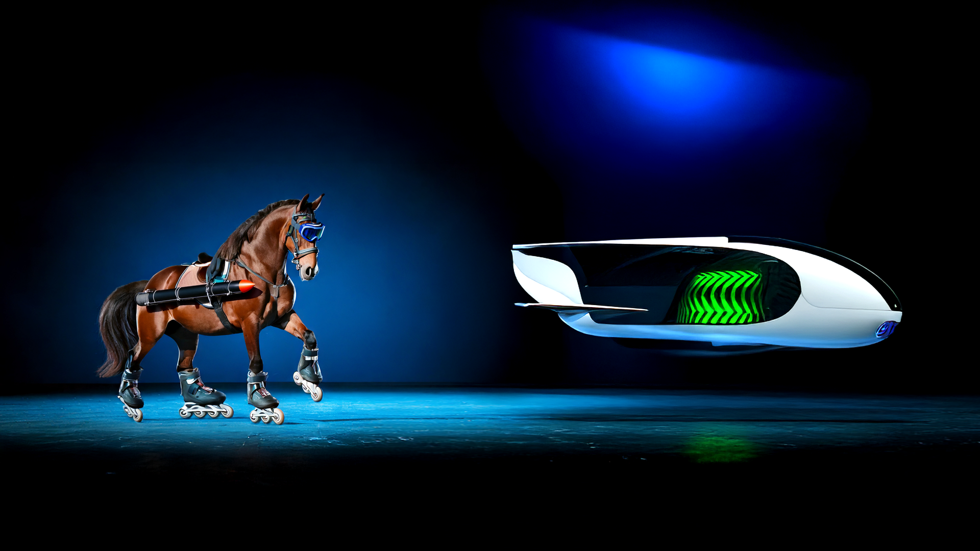
The journey is all about moving from
Firefly prompt: a shiny ball (later deleted) under a bunch of microscopes, telescopes, cameras and lenses, on a dark blue background
Firefly prompt: a futuristic one person flying vehicle, white carbon fibre made, sleek with green energy
Faster Horses
Next Gen Transporters

Slide 22

Will AI replace Humans in the Insights function?

Slide 23
Artificial
Human

Slide 24
Augmented Intelligence
Artificial Intelligence + Human Intelligence

Slide 25
Impact
Action
Insights Focus
Insights
Knowledge
Data

Slide 26
IMPACT
Action
Actionability Focus
Insights
Knowledge
Data

Slide 27
3
Change
Or…
BE CHANGED
Science of market research
&
Art of creating impact

Slide 28


Where Insights Function was charged with reporting the past, it will now be charged with predicting the future and providing inspiring ideas that will transform the business trajectory

Slide 29

“If you don’t have seat at the table… you’re on the menu.”

Slide 30
WE…

Slide 31
Are the Growth Accelerators

Slide 32
We do this by inspiring people to dream up a future

Slide 33
We provoke Big, Bold Actions

Slide 34
We do all this proactively.

Slide 35

In doing so, we become

Slide 36


Champions of the World

Slide 37
Thank you
Michaela Cortez
Stan Sthanunathan​
stan@i-Genie.AI
4045470432

