Slide 1

Toy brand doubles down to lift brand equity 33%
Stop playing around with slower brand equity feedback and start understanding how to adapt campaigns to drive sustained growth
Notes:
33

Slide 2
Business challenge:
A leading toy brand faced declining sales and launched a massive TV and digital campaign to reverse the trend

Slide 3
Business need:
Taking smarter, faster action to supercharge marketing and reinvigorate brand equity

Slide 4

Business questions:
Is my brand strengthening its equity vs competition?
How do I stack-up against ALL the brands?
How do I accelerate/reverse the trend?
Can I have an “Always On” system that monitors all this every month without spending a fortune?
Which of my competitors are declining and why?
How do I create equity-driven market share growth?
Monitor and understand drivers of brand equity for your brands and your competitors without doing a single survey

Slide 5

Measuring sales impact was easy. Measuring brand equity in time was not
The campaign’s goal was to boost both sales and brand equity performance.
Positive or negative
brand equity impact?
The brand couldn’t wait six months to measure the impact of the campaign – they needed to know how to invest or adapt now!
They subscribed to Brand Pulse for rapid measurement of the campaign’s effect on brand equity health.

Slide 6
Quantifying the campaign impact with Brand Pulse
They were able to quantify the campaign's brand impact immediately.
The campaign had a 33% impact on brand equity!
Campaign clocked at driving a big boost to brand equity – 33% from a BPS of 43 to 57!
+33%
Brand equity score has a 0.75 correlation with market share 4 months out!​

Slide 7
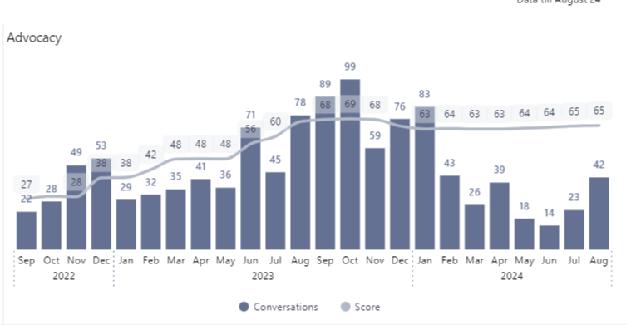
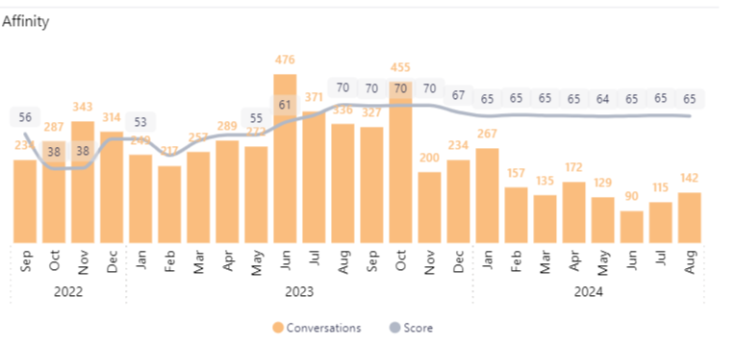
Digging into equity driver analysis to guide messaging updates
They were able to quantify the campaign's brand impact into specific equity drivers like Price, Superiority, Trust, Loyalty and more.
Campaign had biggest surges in Advocacy and Affinity – messages to reinforce
Details showed how the campaign most impacted Advocacy and Affinity, driving a significant Brand Pulse Score change.
They used this to focus their messaging in their updated campaign messaging.
With swift insights, they were able to update creative and spend immediately, in time to impact their campaign.
Faster
Cheaper
Better

Slide 8
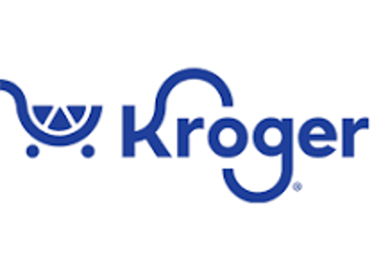


Got questions? i-Genie.ai has answers
Designed for both structured queries and ad hoc querying
Faster
Cheaper
Better
Monitor brand equity in near real-time, so you can react and adapt marketing spend
Align social and review signals all in one place without additional data engineering
Track all competitors, before they become imminent threats
Costs 3-6x less than surveys
Provides access to all your brand managers for a fixed price
Leverages social and review investment across other i-Genie.ai products
Provides Presto, our GenAI to drill down without custom internal requests
Uses 1,000x+ feedback of limited surveys
Tracks all competitors, not just 10-12, with unlimited attribute tracking
Analyzes 7 key pillars vs. traditional 3
Measures 2-year history immediately
Synthesizes key equity drivers with AI

Slide 9

Are you ready for faster, cheaper, better
brand equity tracking?
Reach out to us at contact@i-genie.ai

Slide 10



© i-Genie.ai 2026

