Slide 1

Multinational hair care brand launches best-selling product with CX Bench
Identify pains and unmet needs in markets with hairy competition
Notes:
33

Slide 2
Business challenge:
90%+ of new product launches fail.
Customers don’t want to talk TO brands
…but talk ABOUT brands all the time.
Are you listening?

Slide 3

Business questions:
How is my new launch performing?
Is there a competitor going faster in the passing lane?
Why do people like or dislike my product?
What aspect of my product should I amplify?
What guidance can I provide for improving CX?
Are there hidden gems in my portfolio?
What are the gaps in my competitor’s portfolio?
Benchmark your product experience vs competition
and understand drivers of good and bad performance
Powered by reviews from every SKU in the market

Slide 4

Some market questions can’t be answered from a
100- or 1,000-person survey
The Hair Care market is fierce, with giants holding strong and disruptors rising.
The US Hair Care Market Can’t Be Captured In A Survey
1,919
Brands
New SKUs are launching at higher velocities, targeting unmet needs in the market and challenging incumbents.
120,697
SKUs
A leading FMCG client wanted to understand how they can boost sales in their retailer channels with improved marketing and better targeted products via increased understanding of customer needs.
29,560
Product launches last 6 months
Photo by Vinicius "amnx" Amano on Unsplash
With so many SKUs across so many retailers, surveys and focus groups couldn’t provide the detailed visibility they needed.
2,203,106
Reviews
Enter i-Genie.ai’s CX Bench: Augmented Intelligence to understand CX drivers with data from every SKU in the market

Slide 5
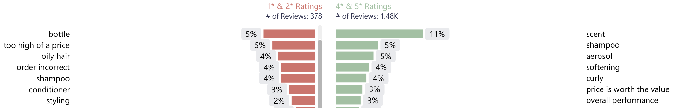
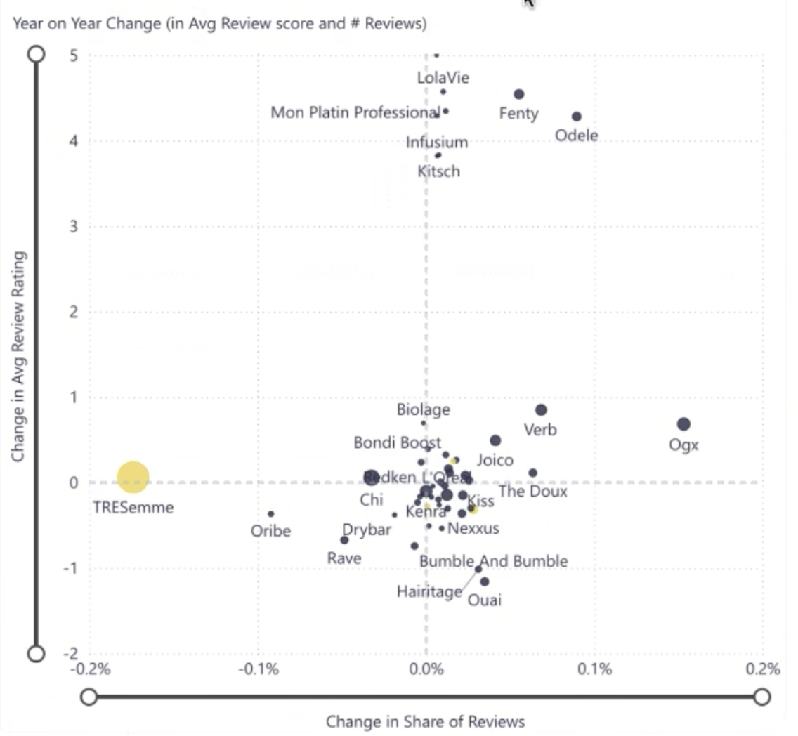
Understand drivers of bad customer experience in your products and category and unmet needs in the market
Whole market data empowered the client to:
Drivers & Detractors
Filter by pain points and by brand – and compare to the category overall – “bottle” is the biggest topic driver of negative reviews!
Understand competitive landscape for product attributes like ”gentleness”.
Competitive Landscape for Heat Protection
Positive review
gaining brands
Compare multiple retailer reports in a single platform to diagnose retailer specific issues:
Amazon, Walmart Ulta, etc. in US
Superdrugs, Boots, LookFantastic, etc. in UK
Change in Avg Review Rating
Identify which competitors were investing in promoted reviews and how those campaigns were influencing consumer perception.
Rapidly gaining
share
Rapidly losing
share
Change in Share of Reviews

Slide 6
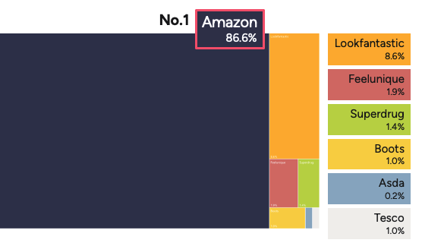
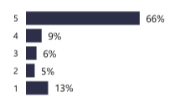
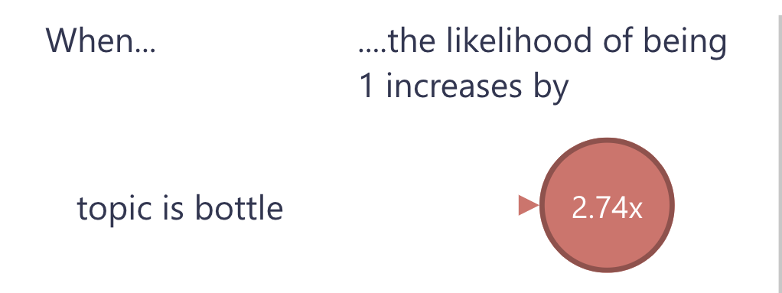
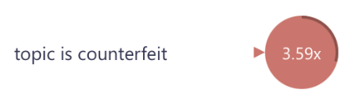
Diagnose issues with their current product CX and take corrective action
From Insight to Action. Fixing unseen issues:
Distribution of Reviews
Detected unusual negative reviews on Amazon, their biggest retailer, for packaging leaks and bottle issues.
Discovered the source was counterfeits, worked with Amazon to remove them and updated messaging highlighting “Authentic” SKUs.
Amazon Star Rating
Discovered shipping issues with another key retailer partner and worked with them directly to resolve.
Topical Drivers For 1★ Reviews

Slide 7
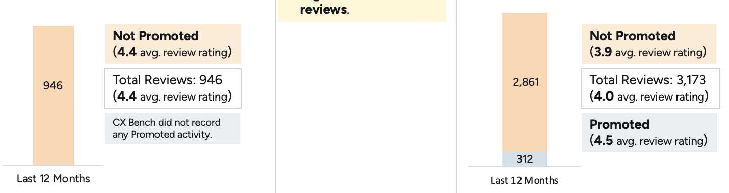
Improve marketing messaging and strategy, driving sales lift
From Insight to Action. Improved messaging:
Learned from a competitor to invest more deeply in promoted reviews coordinated with cohesive storytelling.
Reviews: Promoted vs Non-Promoted
Client Brand
Competitor
Updated SKU messaging addressing new claims such as “lifting roots”.
Informed social media campaigns for a heat-protectant product based on benefit perception.
Understanding Value Drivers
“Value is great and it's super effective. Its given so much volume and lift to my hair all over, especially at the roots. “
“ I always use before heat styling my hair. Helps with preventing any damage and keeps my hair smooth and soft. It smells really good too. Easy to hold bottle and great value for money.”
Revamped their “gentleness” messaging to be more science-based after understanding the attribute overlap in consumer perception.
“The product feels premium, and it's backed by science and dermatologically tested. After using it, my hair felt cleaner and a bit stronger. It's gentle on the scalp, and I love that it uses natural ingredients.”
And…

Slide 8
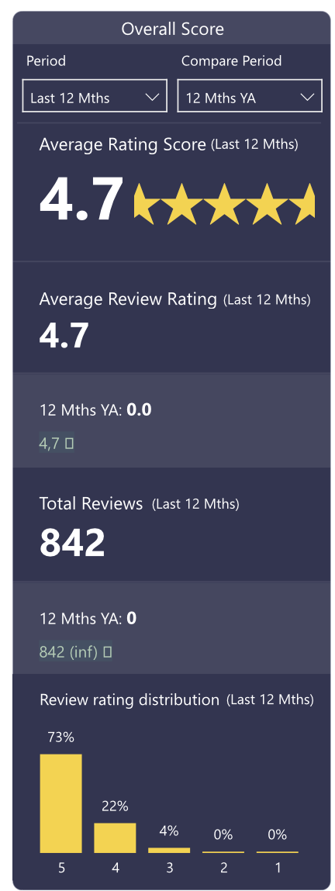
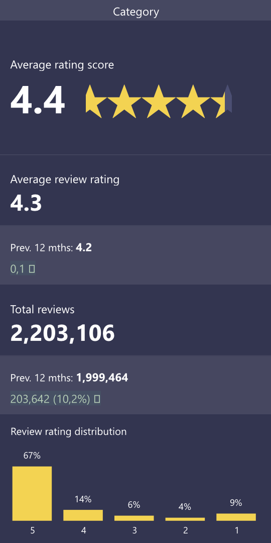
Launch new top performing product – 4.7★ vs. 4.4 avg with no 1★ or 2★ reviews
From Insight to Action:
Launched a product tackling the unmet need of the first heat protectant that could be applied to dry hair.
The client knew immediately the product was a hit! They received the most customer review feedback 30 days after launch of any of their new products.
The product had no 1★ or 2★ reviews – extraordinarily positive feedback!
Marked as a “best-seller” on Amazon, further propelling sales by juicing Amazon’s discovery algorithm.

Slide 9


Got questions? i-Genie.ai has answers
Designed for both structured queries and ad hoc querying
Faster
Cheaper
Better
Get advanced CX analyses in time to react to marketing or product launches​
Get insights earlier with larger review sample sizes​
Identify up-and-coming brands and products earlier with full market data​
Less expensive than costly product feedback surveys​
Less expensive than competitors with full market data across every SKU
Less manual data analyses with built-in NLP and Master Data Management
Crawls 10,000s of product page URLs for comprehensive review feedback​
Expansive retailer coverage that you define​
Tracks all competitors and all SKUs not a limited subset​
Customized Master Data Management to segment the market the way you want

Slide 10
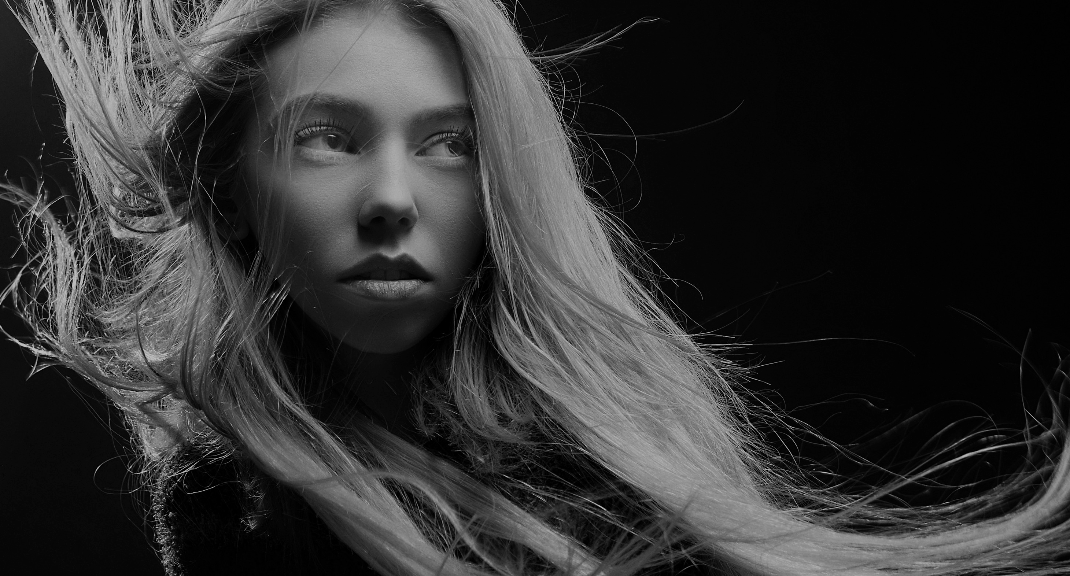
What i-Genie.ai customers say about us…
CMI & Analytics Director
“We have enjoyed pioneering with i-Genie.ai using their innovative cutting-edge tech tools, enabling fewer primary surveys to get to the hear of what consumers want and need. Their collaborative, responsive working style means that they are an extension of our team. Always eager for feedback and where possible adjust and customize to help us drive our business forward.”
Photo by Alexander Krivitskiy on Unsplash

Slide 11

Are you ready for faster, cheaper, better
product benchmarking?
Reach out to us at contact@i-genie.ai

Slide 12



© i-Genie.ai 2026

