Slide 1

Hair care giant uses BP
to boost brand equity 8.3%
FMCG adopts the new standard for brand equity monitoring
Notes:
33

Slide 2
Business challenge:
Taking smarter, faster action in a highly competitive and shifting Hair Care market

Slide 3
Business need:
Taking smarter, faster action to supercharge marketing and reinvigorate brand equity

Slide 4

Business questions:
Is my brand strengthening its equity vs competition?
How do I stack-up against ALL the brands?
How do I accelerate/reverse the trend?
Can I have an “Always On” system that monitors all this every month without spending a fortune?
Which of my competitors are declining and why?
How do I create equity-driven market share growth?
Monitor and understand drivers of brand equity for your brands and your competitors without doing a single survey

Slide 5
The Hair Care market is fierce
The Hair Care market is fierce, with giants holding strong and disruptors rising.
Brand Pulse Score: Hair Care US (sample brands)
A leading FMCG client was stagnating and needed a fast turnaround.
With limited budget and time, traditional surveys weren’t an option. They needed deeper, action-driven insights beyond those from a normal survey.

Slide 6
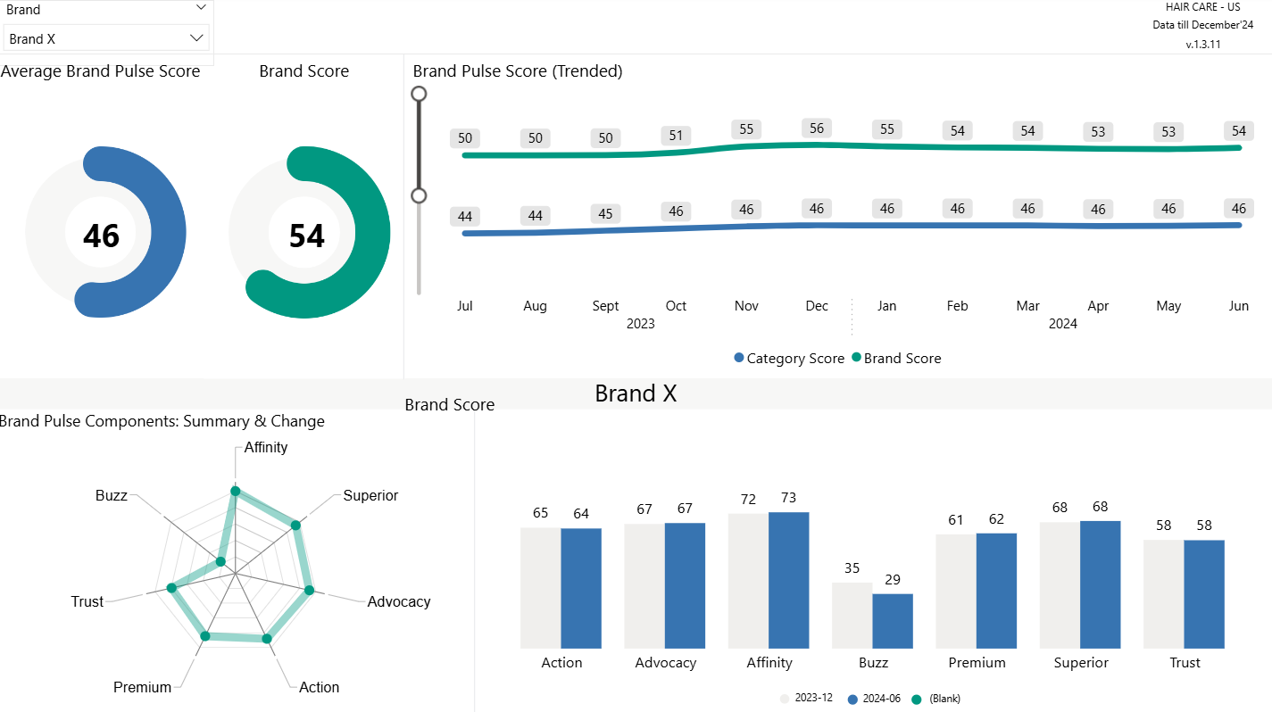
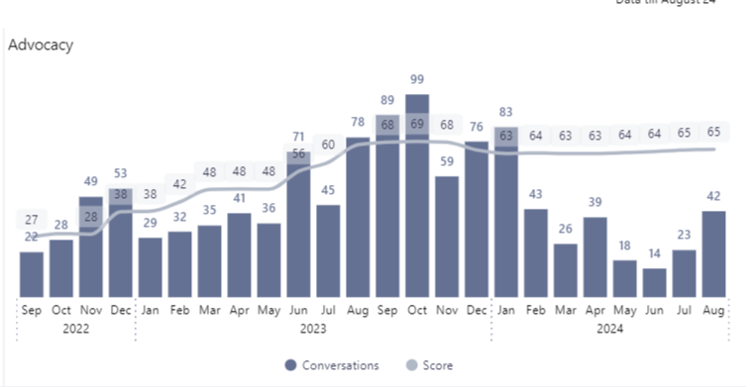
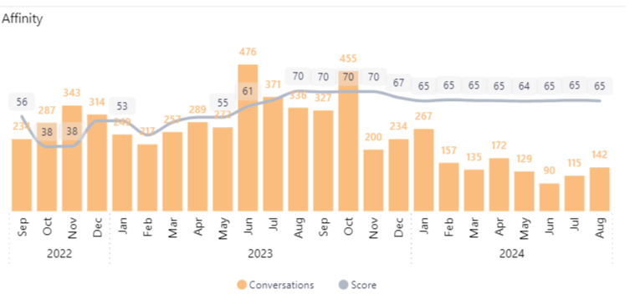
Within minutes of logging in, our client confirmed their stagnation hypothesis
With just a few clicks, our client was able to test their brand stagnation hypothesis
Hair Care US: client Brand Pulse Score brand breakdown view
In their brand overview, they saw that despite outperforming the category average, brand equity remained stagnant
They were also able to see the drivers of brand equity and could see that their Buzz had dropped significantly – 17%.

Slide 7
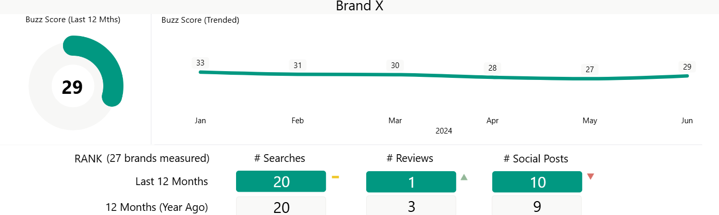
Getting to a clear diagnosis in just a few clicks
Seeing their Buzz had dropped, our client deep-dived into what was happening.
Client brand: Buzz performance by month and by data source
Buzz, i-Genie.ai’s salience metric, measures share of voice across eCommerce reviews, searches and social platforms.
They could see that the decline in Buzz was due to a decline in social posts and stagnant, low, searches – despite an increase in reviews.

Slide 8
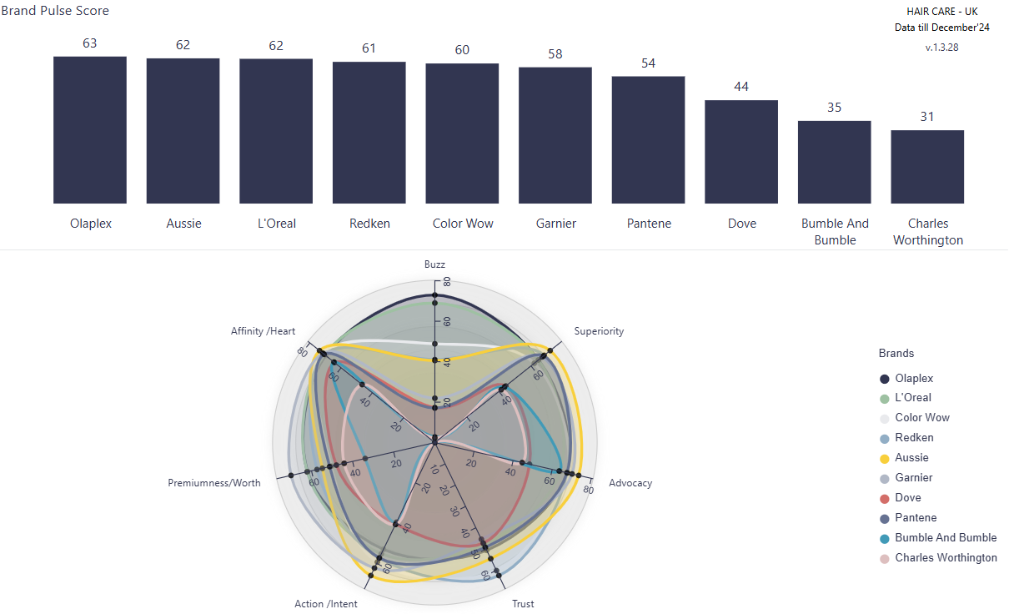
Getting to a clear diagnosis in just a few clicks
Our client looked at the part Buzz plays in brand equity for the whole market.
Hair Care US: BP scores and dimensions breakdown by selected brands
Exploring the tool, our client uncovered a key trend – top brands win on Buzz.
Moreover, an interesting datapoint emerged – top brands were doing very well on Trust.
Trust is i-Genie.ai’s measure of consumer perceptions of a brand’s trustworthiness and heritage.

Slide 9
Our data gave our client inspiration for a clear action plan on how to re-invigorate their brand
The biggest boosts to brand equity were identified – Buzz and Trust – by analysing the top players vs. market.
Hair Care US: BPS components, analysed by dimension for understanding what gives the biggest boost
 | Buzz (avg.) | Superiority (avg.) | Advocacy (avg.) | Trust (avg.) | Action (avg.) | Value (avg.) | Affinity (avg.)
BP - All Brands | 16 | 51 | 49 | 34 | 43 | 45 | 58
Top 5 brands | 46 | 68 | 71 | 55 | 60 | 58 | 73
Ratio | 2.88 | 1.33 | 1.45 | 1.62 | 1.40 | 1.29 | 1.26
This enabled our client to devise a plan:
Launch a buzz-driving campaign that sparks online and social engagement
Leverage brand heritage in the campaign to encourage consumers to discuss their Trust in the brand
Give consumers a clear call to action to search for the brand

Slide 10
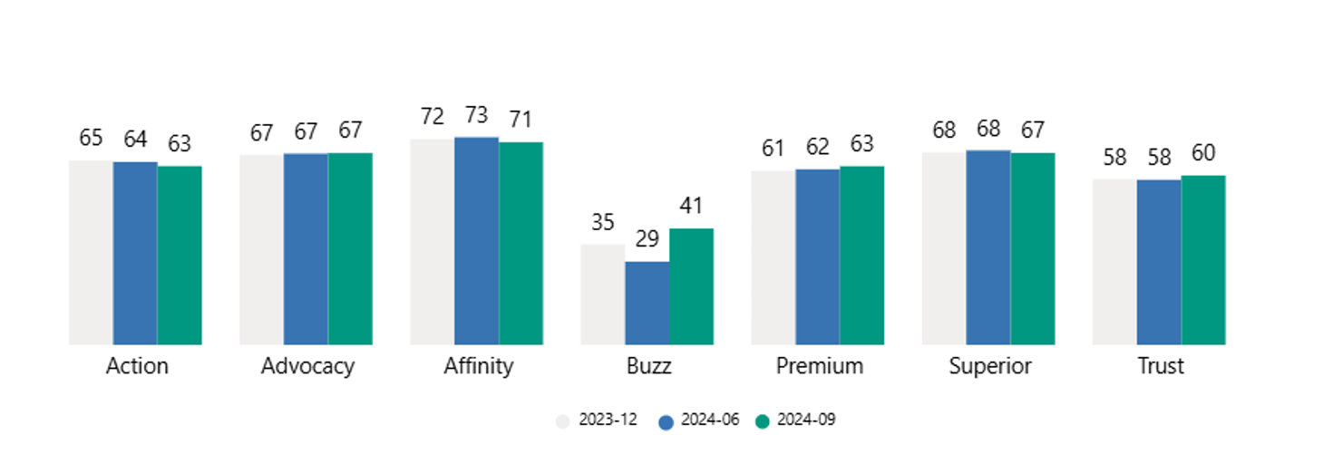
The result: an 8.3% increase in Brand Equity post-campaign – in just 3 months
The impact was visible immediately after their campaign began. In just 3 months:
Brand equity was up – an 8.3% increase
A 41% increase in Buzz, up 12pts to 41, reversing negative trend
Trust score uplift of 4%
The impact of an i-Genie.ai informed marketing campaign was immediately clear
+8.3%
+41%
Brand equity score has a 0.75 correlation with market share 4 months out!
Brand Equity score
Buzz Score

Slide 11
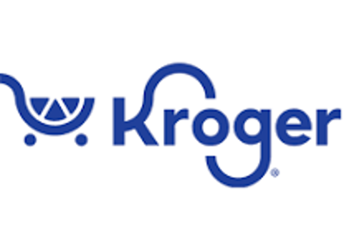

What i-Genie.ai customers say about us…
CMI & Analytics Director
“We have enjoyed pioneering with i-Genie.ai using their innovative cutting-edge tech tools, enabling fewer primary surveys to get to the hear of what consumers want and need. Their collaborative, responsive working style means that they are an extension of our team. Always eager for feedback and where possible adjust and customize to help us drive our business forward.”
Photo by Alexander Krivitskiy on Unsplash

Slide 12


Got questions? i-Genie.ai has answers
Designed for both structured queries and ad hoc querying
Faster
Cheaper
Better
Monitor brand equity in near real-time, so you can react and adapt marketing spend
Align social and review signals all in one place without additional data engineering
Track all competitors, before they become imminent threats
Costs 3-6x less than surveys
Provides access to all your brand managers for a fixed price
Leverages social and review investment across other i-Genie.ai products
Provides Presto, our GenAI to drill down without custom internal requests
Uses 1,000x+ feedback of limited surveys
Tracks all competitors, not just 10-12, with unlimited attribute tracking
Analyzes 7 key pillars vs. traditional 3
Measures 2-year history immediately
Synthesizes key equity drivers with AI

Slide 13

Are you ready for faster, cheaper, better
brand equity tracking?
Reach out to us at contact@i-genie.ai

Slide 14



© i-Genie.ai 2026

